Slide 1
Reading Form Data
import { useState } from "react";
import ReactDOM from "react-dom";
export default function MyForm() {
const [inputs, setInputs] = useState({ myCar: "Volvo" });
const handleChange = (event) => {
const name = event.target.name;
const value = event.target.value;
setInputs(values => ({ ...values, [name]: value }))
}
const handleSubmit = (event) => {
event.preventDefault();
alert(inputs.age + " " + inputs.username + " " + inputs.myCar);
}
return (
<form onSubmit={handleSubmit}>
<label>Enter your name:
<input
type="text"
name="username"
value={inputs.username || ""}
onChange={handleChange}
/>
</label>
<label>Enter your age:
<input
type="number"
name="age"
value={inputs.age || ""}
onChange={handleChange}
/>
</label>
<select value={inputs.myCar} name="myCar"
onChange={handleChange}>
<option value="Ford">Ford</option>
<option value="Volvo">Volvo</option>
<option value="Fiat">Fiat</option>
</select>
<input type="submit" />
</form>
)
}
username:Vita
age:25
myCar:Volvo
input

Slide 2
Dynamic drop down
return (
<form onSubmit={handleSubmit}>
<label>Enter your name:
<input
type="text"
name="username"
value={inputs.username || ""}
onChange={handleChange}
/>
</label>
<label>Enter your age:
<input
type="number"
name="age"
value={inputs.age || ""}
onChange={handleChange}
/>
</label>
<select value={inputs.myCar} name="myCar" onChange={handleChange}>
{listcar.map((d,i)=><option value={d} key={i}>{d}</option>)
}
</select>
<input type="submit" />
</form>
)
}
import { useState } from "react";
import ReactDOM from "react-dom";
export default function MyForm() {
const [inputs, setInputs] = useState({ myCar: "Volvo" });
const listcar=["Volvo","Ford","Fiat"];
const handleChange = (event) => {
const name = event.target.name;
const value = event.target.value;
setInputs(values => ({ ...values, [name]: value }))
}
const handleSubmit = (event) => {
event.preventDefault();
alert(inputs.age + " " + inputs.username + " " + inputs.myCar);
}

Slide 3
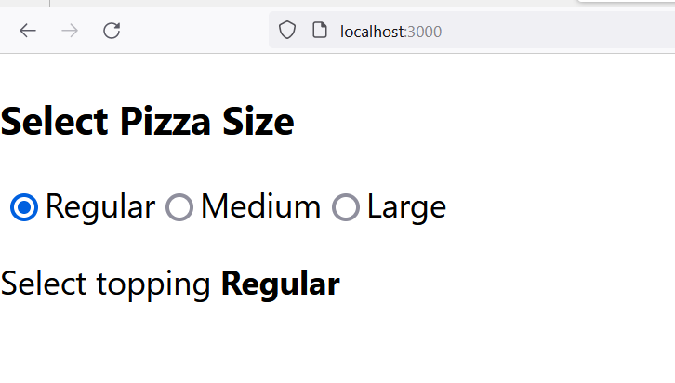
import { useState } from "react"
function App() {
const [topping, setTopping] = useState(null)
const onOptionChange = e => {
setTopping(e.target.value)
}
return (
<div className="App">
<h3>Select Pizza Size</h3>
<input
type="radio"
name="topping"
value="Regular"
id="regular"
checked={topping === "Regular"}
onChange={onOptionChange}
/>
<label htmlFor="regular">Regular</label>
<input
type="radio"
name="topping"
value="Medium"
id="medium"
checked={topping === "Medium"}
onChange={onOptionChange}
/>
<label htmlFor="medium">Medium</label>
<input
type="radio"
name="topping"
value="Large"
id="large"
checked={topping === "Large"}
onChange={onOptionChange}
/>
<label htmlFor="large">Large</label>
<p>
Select topping <strong>{topping}</strong>
</p>
</div>
)
}
export default App

Slide 4
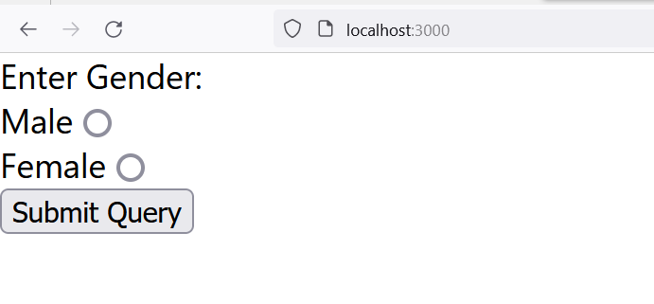
Dynamic Rdio
import { useState } from "react";
import ReactDOM from "react-dom";
export default function App() {
const gender=["Male","Female"];
const [inputsrd, setInputsrd] = useState(null);
const handleChange = (event) => {
setInputsrd(event.target.value);
}
const handleSubmit = (event) => {
event.preventDefault();
alert(inputsrd);
}
return (
<form onSubmit={handleSubmit}>
<label>Enter Gender:</label>
{gender.map((g,i)=>
{ return <div>
<label key="i">{g}</label>
<input type="radio" name="nm" value={g} onClick={handleChange}/>
</div>
})
}
<input type="submit" />
</form>
)
}

Slide 5
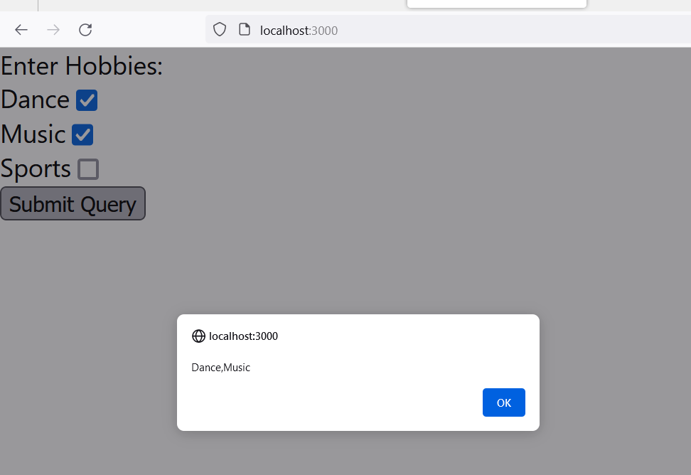

Slide 6
import { useState } from "react";
import ReactDOM from "react-dom";
export default function App() {
const gender=["Dance","Music","Sports"];
const [inputsrd, setInputsrd] = useState([]);
const handleChange = (event) => {
setInputsrd((t)=>[...t, event.target.value]);
}
const handleSubmit = (event) => {
event.preventDefault();
alert([inputsrd]);
}
return (
<form onSubmit={handleSubmit}>
<label>Enter Hobbies:</label>
{gender.map((g,i)=>
{ return <div>
<label key="i">{g}</label>
<input type="checkbox" name={"nm"+i} value={g} onClick={handleChange}/>
</div>
})
}
<input type="submit" />
</form>
)
}

